Slide 1
To DFS / BFS – Deprived
If you do not know what DFS or BFS are, and Ch. 3 is not enough of a review for you, please see the TAs ASAP
  CS173 (Prereq.) covers BFS,DFS in detail
  Alternative classes in ECE should have covered those (let me know if not)

Slide 2
Problem-Solving Agent
sensors
?
environment
agent
actuators

Slide 3
Problem-Solving Agent
sensors
?
environment
agent
actuators
Formulate Goal
Formulate Problem
  States
  Actions
Find Solution

Slide 4
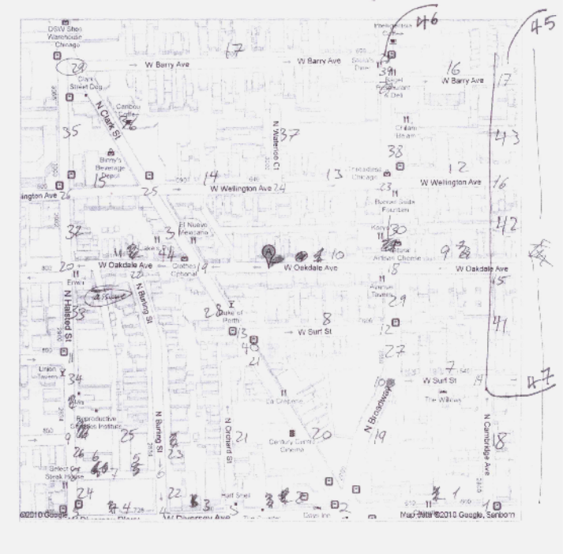
Example Problem
Start Street
Street with
Parking

Slide 5
Looking for Parking
Going home; need to find street parking
Formulate Goal:
  Car is parked
Formulate Problem:
  States: street with parking and car at that street
  Actions: drive between street segments
Find solution:
  Sequence of street segments, ending with a street with parking

Slide 6
Problem Formulation
Start Street
Search
Path
Street with
Parking

Slide 7
Search Problem
State space
  each state is an abstract representation of the environment
  the state space is discrete
Initial state
Successor function
Goal test
Path cost

Slide 8
Search Problem
State space
Initial state:
  usually the current state
  sometimes one or several hypothetical states (“what if …”)
Successor function
Goal test
Path cost

Slide 9
Search Problem
State space
Initial state
Successor function:
  [state → subset of states]
  an abstract representation of the possible actions
Goal test
Path cost

Slide 10
Search Problem
State space
Initial state
Successor function
Goal test:
  usually a condition
  sometimes the description of a state
Path cost

Slide 11
Search Problem
State space
Initial state
Successor function
Goal test
Path cost:
  [path → positive number]
  usually, path cost = sum of step costs
  e.g., number of moves of the empty tile

Slide 12
Assumptions in Basic Search
The environment is static
The environment is discretizable
The environment is observable
The actions are deterministic

Slide 13
Search Space Size
Unlike Search in CS225, AI encounters search spaces that are too large
AI Search typically does not realize the entire search graph or state space
Examples
  Scheduling CS classes such that every student in every program of study can take every class they wish
  Search for shortest path that covers all streets (Travelling Salesman Problem)

Slide 14
Search Space Size
Scheduling CS classes such that every student in every program of study can take every class they wish
States = ?
State Space Size = ?
Search Time = ?

Slide 15
Search Space Size
Search for shortest path that covers all streets (Travelling Salesman Problem)
State = ?
State Space Size = ?
Search Time = ?

Slide 16
Simple Agent Algorithm
Problem-Solving-Agent
initial-state ← sense/read state
goal ← select/read goal
successor ← select/read action models
problem ← (initial-state, goal, successor)
solution ← search(problem)
perform(solution)

Slide 17
Basic Search Concepts
Search tree
Search node
Node expansion
Search strategy: At each stage it determines which node to expand

Slide 18
Node Data Structure
STATE
PARENT
ACTION
COST
DEPTH
If a state is too large, it may
be preferable to only represent the
initial state and (re-)generate the
other states when needed

Slide 19
Fringe
Set of search nodes that have not been expanded yet
Implemented as a queue FRINGE
  INSERT(node,FRINGE)
  REMOVE(FRINGE)
The ordering of the nodes in FRINGE defines the search strategy

Slide 20
Search Algorithm
If GOAL?(initial-state) then return initial-state
INSERT(initial-node,FRINGE)
Repeat:
  If FRINGE is empty then return failure
  n ← REMOVE(FRINGE)
  s ← STATE(n)
  For every state s’ in SUCCESSORS(s)
    Create a node n’
    If GOAL?(s’) then return path or goal state
    INSERT(n’,FRINGE)

Slide 21
Search Strategies
A strategy is defined by picking the order of node expansion
Performance Measures:
  Completeness – does it always find a solution if one exists?
  Time complexity – number of nodes generated/expanded
  Space complexity – maximum number of nodes in memory
  Optimality – does it always find a least-cost solution
Time and space complexity are measured in terms of
  b – maximum branching factor of the search tree
  d – depth of the least-cost solution
  m – maximum depth of the state space (may be ∞)

Slide 22
Remark
Some problems formulated as search problems are NP-hard problems. We cannot expect to solve such a problem in less than exponential time in the worst-case
But we can nevertheless strive to solve as many instances of the problem as possible

Slide 23
Blind vs. Heuristic Strategies
Blind (or uninformed) strategies do not exploit any of the information contained in a state
Heuristic (or informed) strategies exploits such information to assess that one node is “more promising” than another

Slide 24
Blind Strategies
Breadth-first
  Bidirectional
Depth-first
  Depth-limited
  Iterative deepening
Uniform-Cost
Step cost = 1
Step cost = c(action)
≥ ε > 0

Slide 25
Breadth-First Strategy
New nodes are inserted at the end of FRINGE
1
2
3
FRINGE = (1)
4
5
6
7

Slide 26
Breadth-First Strategy
New nodes are inserted at the end of FRINGE
1
2
3
FRINGE = (2, 3)
4
5
6
7

Slide 27
Breadth-First Strategy
New nodes are inserted at the end of FRINGE
1
2
3
FRINGE = (3, 4, 5)
4
5
6
7

Slide 28
Breadth-First Strategy
New nodes are inserted at the end of FRINGE
1
2
3
FRINGE = (4, 5, 6, 7)
4
5
6
7

Slide 29
Evaluation
b: branching factor
d: depth of shallowest goal node
Complete
Optimal if step cost is 1
Number of nodes generated:
1 + b + b² + … + b^{d} + b(b^{d}-1) = O(b^{d+1})
Time and space complexity is O(b^{d+1})

Slide 30
Time and Memory Requirements
d | #Nodes | Time | Memory
2 | 111 | .01 msec | 11 Kbytes
4 | 11,111 | 1 msec | 1 Mbyte
6 | ~10⁶ | 1 sec | 100 Mb
8 | ~10⁸ | 100 sec | 10 Gbytes
10 | ~10¹⁰ | 2.8 hours | 1 Tbyte
12 | ~10¹² | 11.6 days | 100 Tbytes
14 | ~10¹⁴ | 3.2 years | 10,000 Tb
Assumptions: b = 10; 1,000,000 nodes/sec; 100bytes/node
Notes:
Note that this table is for different assumptions that the one in R&N

Slide 31
Time and Memory Requirements
d | #Nodes | Time | Memory
2 | 111 | .01 msec | 11 Kbytes
4 | 11,111 | 1 msec | 1 Mbyte
6 | ~10⁶ | 1 sec | 100 Mb
8 | ~10⁸ | 100 sec | 10 Gbytes
10 | ~10¹⁰ | 2.8 hours | 1 Tbyte
12 | ~10¹² | 11.6 days | 100 Tbytes
14 | ~10¹⁴ | 3.2 years | 10,000 Tb
Assumptions: b = 10; 1,000,000 nodes/sec; 100bytes/node

Slide 32
Bidirectional Strategy
2 fringe queues: FRINGE1 and FRINGE2
Time and space complexity = O(b^{d/2}) << O(b^{d})

Slide 33
Depth-First Strategy
New nodes are inserted at the front of FRINGE
1
2
3
FRINGE = (1)
4
5

Slide 34
Depth-First Strategy
New nodes are inserted at the front of FRINGE
1
2
3
FRINGE = (2, 3)
4
5

Slide 35
Depth-First Strategy
New nodes are inserted at the front of FRINGE
1
2
3
FRINGE = (4, 5, 3)
4
5

Slide 36
Depth-First Strategy
New nodes are inserted at the front of FRINGE
1
2
3
4
5

Slide 37
Depth-First Strategy
New nodes are inserted at the front of FRINGE
1
2
3
4
5

Slide 38
Depth-First Strategy
New nodes are inserted at the front of FRINGE
1
2
3
4
5

Slide 39
Depth-First Strategy
New nodes are inserted at the front of FRINGE
1
2
3
4
5

Slide 40
Depth-First Strategy
New nodes are inserted at the front of FRINGE
1
2
3
4
5

Slide 41
Depth-First Strategy
New nodes are inserted at the front of FRINGE
1
2
3
4
5

Slide 42
Depth-First Strategy
New nodes are inserted at the front of FRINGE
1
2
3
4
5

Slide 43
Depth-First Strategy
New nodes are inserted at the front of FRINGE
1
2
3
4
5

Slide 44
Evaluation
b: branching factor
d: depth of shallowest goal node
m: maximal depth of a leaf node
Complete only for finite search tree
Not optimal
Number of nodes generated:
1 + b + b² + … + b^{m} = O(b^{m})
Time complexity is O(b^{m})
Space complexity is O(bm)

Slide 45
Depth-Limited Strategy
Depth-first with depth cutoff k (maximal depth below which nodes are not expanded)
Three possible outcomes:
  Solution
  Failure (no solution)
  Cutoff (no solution within cutoff)

Slide 46
Iterative Deepening Strategy
Repeat for k = 0, 1, 2, …:
  Perform depth-first with depth cutoff k
Complete
Optimal if step cost =1
Time complexity is:
(d+1)(1) + db + (d-1)b² + … + (1) b^{d} = O(b^{d})
Space complexity is: O(bd)

Slide 47
Comparison of Strategies
Breadth-first is complete and optimal, but has high space complexity
Depth-first is space efficient, but neither complete nor optimal
Iterative deepening is asymptotically optimal

Slide 48
Repeated States
No
Few
Many
1
2
3
search tree is finite
search tree is infinite
4
5
7
8
6
8-queens
assembly
planning
8-puzzle and robot navigation

Slide 49
Avoiding Repeated States
Requires comparing state descriptions
Breadth-first strategy:
  Keep track of all generated states
  If the state of a new node already exists, then discard the node

Slide 50
Avoiding Repeated States
Depth-first strategy:
  Solution 1:
    Keep track of all states associated with nodes in current tree
    If the state of a new node already exists, then discard the node
  → Avoids loops
  Solution 2:
    Keep track of all states generated so far
    If the state of a new node has already been generated, then discard the node
  → Space complexity of breadth-first

Slide 51
Detecting Identical States
Use explicit representation of state space
Use hash-code or similar representation

Slide 52
Uniform-Cost Strategy
Each step has some cost ≥ ε > 0.
The cost of the path to each fringe node N is
g(N) = Σ costs of all steps.
The goal is to generate a solution path of minimal cost.
The queue FRINGE is sorted in increasing cost.
A
S
0
1
10
S
5
B
5
G
A
B
C
1
5
15
5
15
C
G
G
11
10

Slide 53
Modified Search Algorithm
INSERT(initial-node,FRINGE)
Repeat:
  If FRINGE is empty then return failure
  n ← REMOVE(FRINGE)
  s ← STATE(n)
  If GOAL?(s) then return path or goal state
  For every state s’ in SUCCESSORS(s)
    Create a node n’
    INSERT(n’,FRINGE)

Slide 54
Branch and Bound
If search involves optimization (e.g. shortest path for covering all streets)
  Can record the best path so far, and bound the search when the current path becomes longer than current best path.

Slide 55
Summary
Search tree ≠ state space
Search strategies: breadth-first, depth-first, and variants
Evaluation of strategies: completeness, optimality, time and space complexity
Avoiding repeated states
Optimal search with variable step costs

